Slide 1

Micro-Credit Defaulter Model
Submitted by:
M.KAVITHA

Slide 2
ACKNOWLEDGMENT
I HAVE DONE THIS PROJECT AS PER MY KNOWLEDGE LEARNT FROM THE COURSE.

Slide 3
INTRODUCTION
A Microfinance Institution (MFI) is an organization that offers financial services to low income populations. MFS becomes very useful when targeting especially the unbanked poor families living in remote areas with not much sources of income.

Slide 4
Exploratory Data Analysis(EDA)
We will explore a Data set and perform the exploratory data analysis. The major topics to be covered are below:
– Handle Missing value – Removing duplicates – Outlier Treatment – Normalizing and Scaling( Numerical Variables) – Encoding Categorical variables( Dummy Variables) – Bivariate Analysis

Slide 5
Importing Libraries
import numpy as np
import pandas as pd
import random
import matplotlib.pyplot as plt %matplotlib inline import warnings warnings.filterwarnings("ignore")
We will be loading the EDA cars excel file using pandas. For this, we will be using read_excel file.

Slide 6
# Basic Data Exploration
In this step, we will perform the below operations to check what the data set comprises of. We will check the below things:
– head of the dataset – the shape of the dataset – info of the dataset – summary of the dataset
The head function will tell you the top records in the data set. By default, python shows you only the top 5 records.
The shape attribute tells us a number of observations and variables we have in the data set. It is used to check the dimension of data. The cars data set has 18706 observations and 37variables in the data set.

Slide 7
info() is used to check the Information about the data and the datatypes of each respective attribute.
Info. on the data
df_new.info()

Slide 8
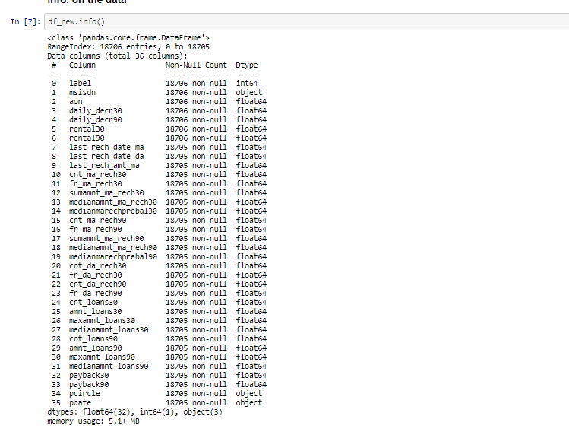
Info. on the data

Slide 9
The described method will help to see how data has been spread for numerical values. We can clearly see the minimum value, mean values, different percentile values, and maximum values.

Slide 10
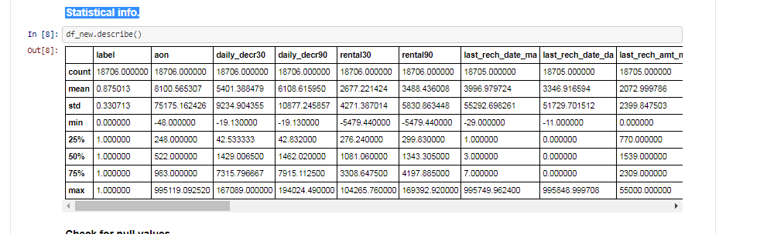
Statistical info.

Slide 11
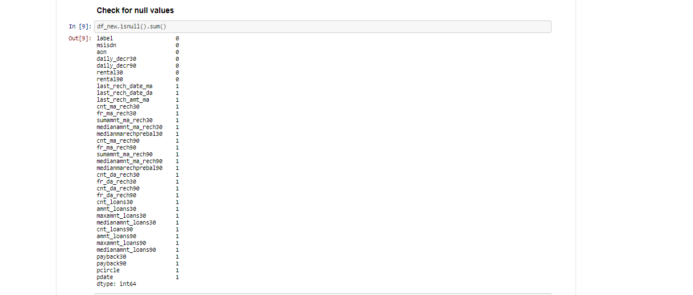
Handling missing value

Slide 12
We can see that we have various missing values in the respective columns. There are various ways of treating your missing values in the data set. And which technique to use when is actually dependent on the type of data you are dealing with.
Drop the missing values: In this case, we drop the missing values from those variables. In case there are very few missing values you can drop those values.
Impute with mean value: For the numerical column, you can replace the missing values with mean values. Before replacing with mean value, it is advisable to check that the variable shouldn’t have extreme values .i.e. outliers.
Impute with median value: For the numerical column, you can also replace the missing values with median values. In case you have extreme values such as outliers it is advisable to use the median approach.
Impute with mode value: For the categorical column, you can replace the missing values with mode values i.e the frequent ones.

Slide 13
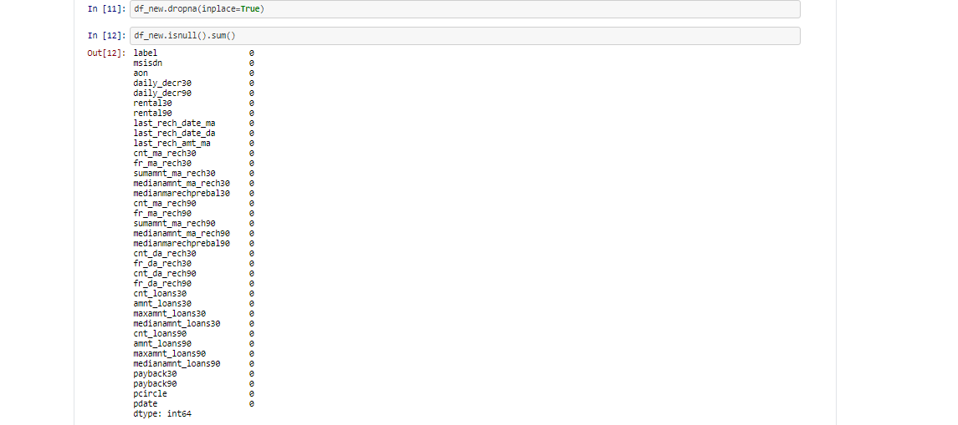

Slide 14
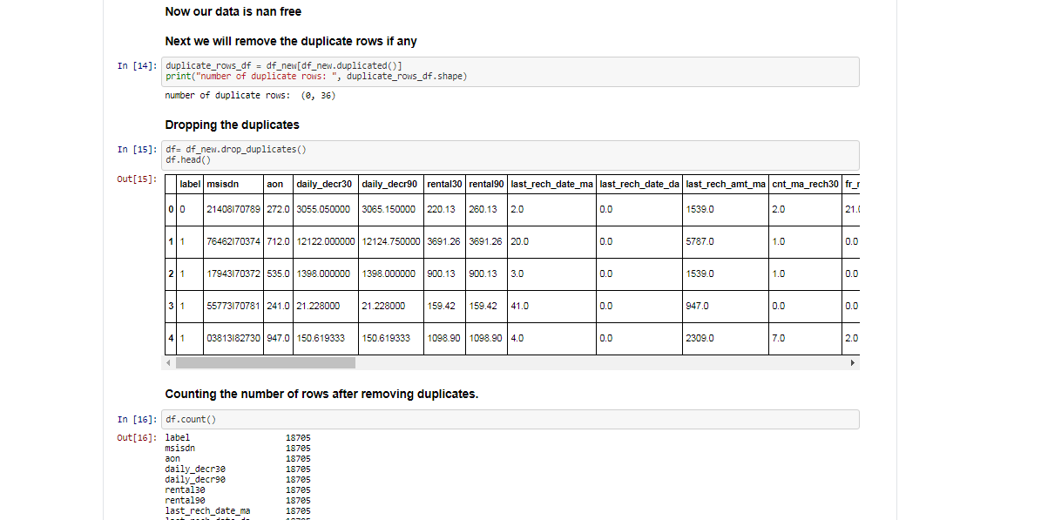
Handling Duplicate records

Slide 15
Since we have 14 duplicate records in the data, we will remove this from the data set so that we get only distinct records. Post removing the duplicate, we will check whether the duplicates have been removed from the data set or not.

Slide 16
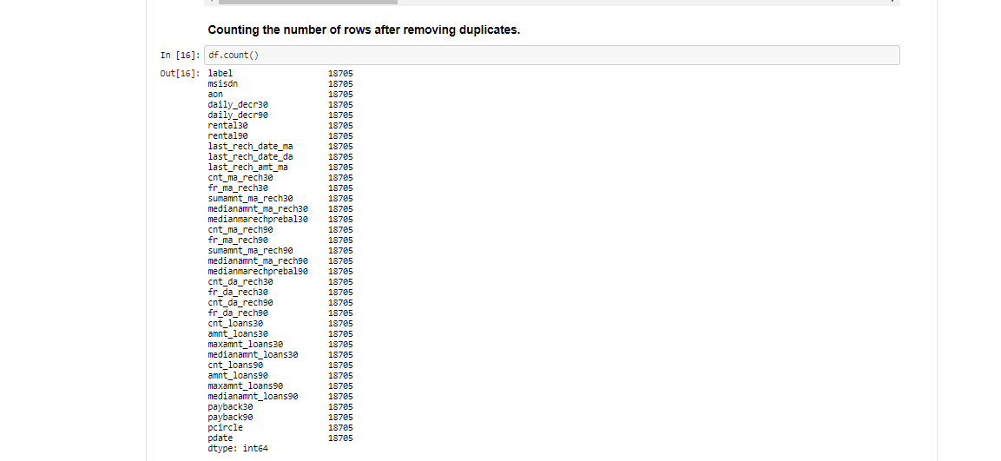

Slide 17
Handling Outlier
Outliers, being the most extreme observations, may include the sample maximum or sample minimum, or both, depending on whether they are extremely high or low. However, the sample maximum and minimum are not always outliers because they may not be unusually far from other observations.
We Generally identify outliers with the help of boxplot, so here box plot shows some of the data points outside the range of the data.

Slide 18
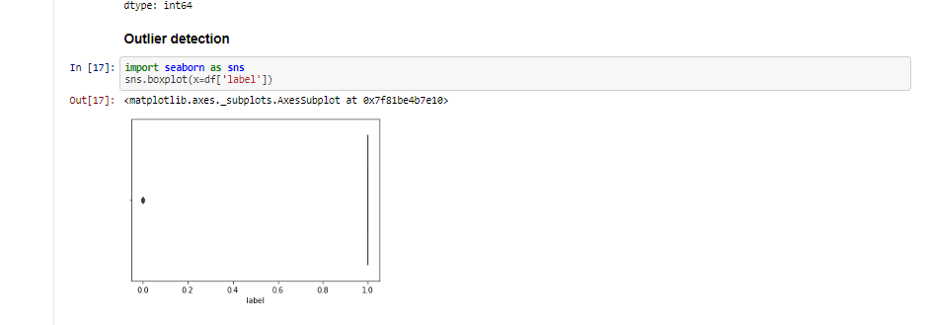

Slide 19
Bivariate Analysis
When we talk about bivariate analysis, it means analyzing 2 variables. Since we know there are numerical and categorical variables, there is a way of analyzing these variables as shown below:
Numerical vs. Numerical
1. Scatterplot 2. Line plot 3. Heatmap for correlation 4. Joint plot
Categorical vs. Numerical
1. Bar chart 2. Violin plot 3. Categorical box plot 4.Swarm plot
Two Categorical Variables
1. Bar chart 2. Grouped bar chart 3. Point plot

Slide 20
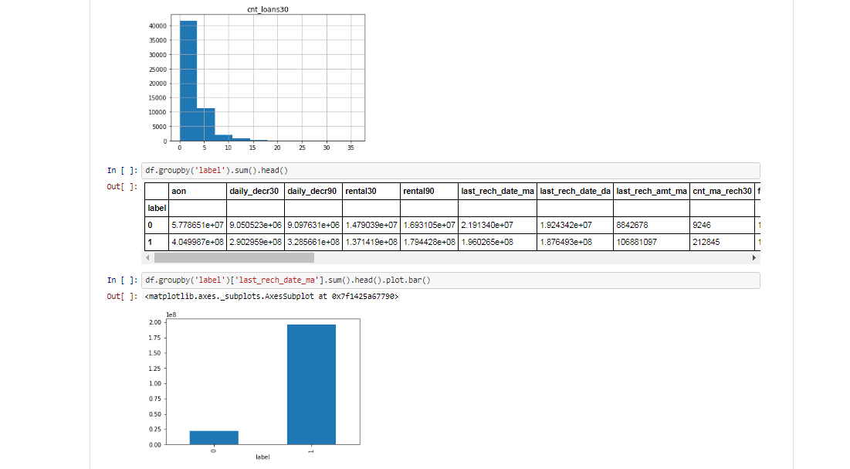

Slide 21
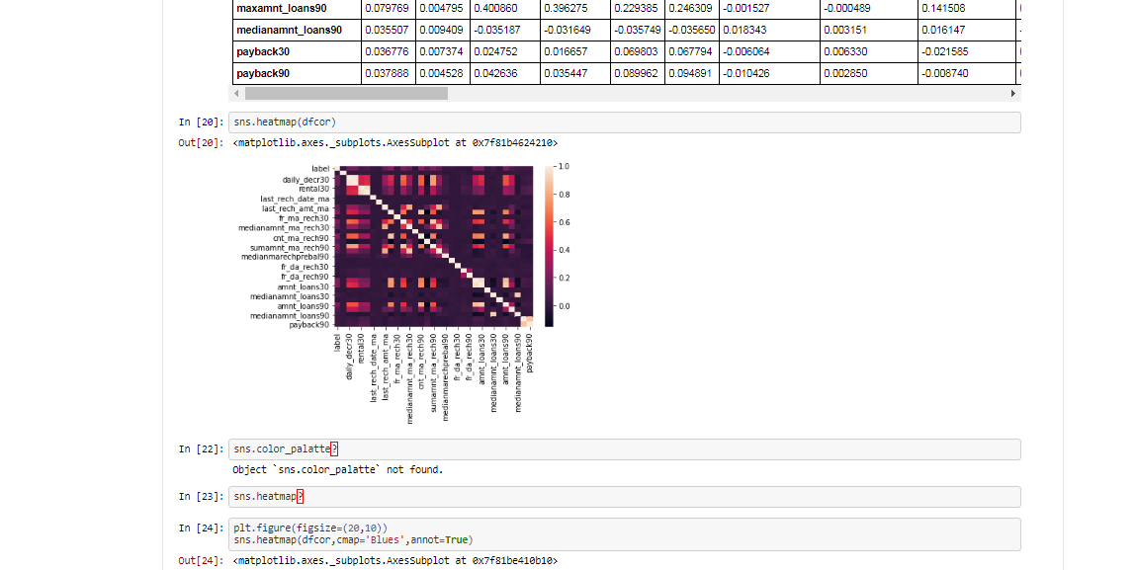
If we need to find the correlation-

Slide 22
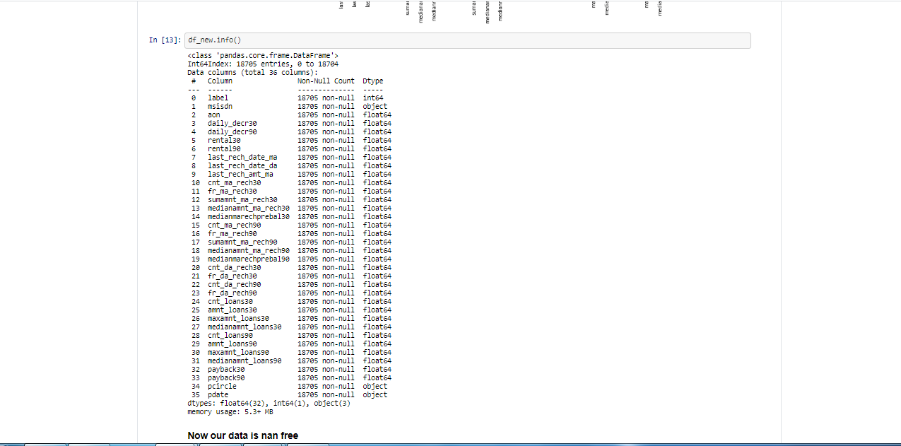

Slide 24
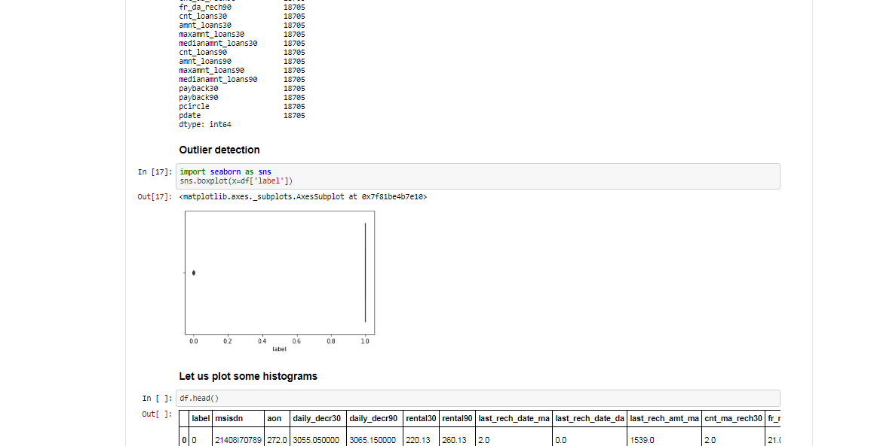

Slide 25
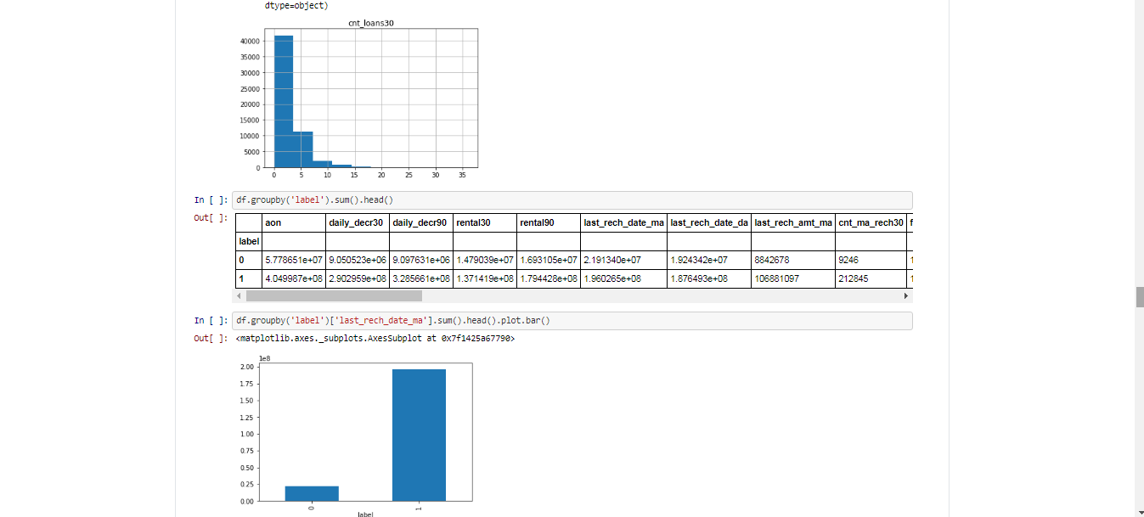

Slide 26
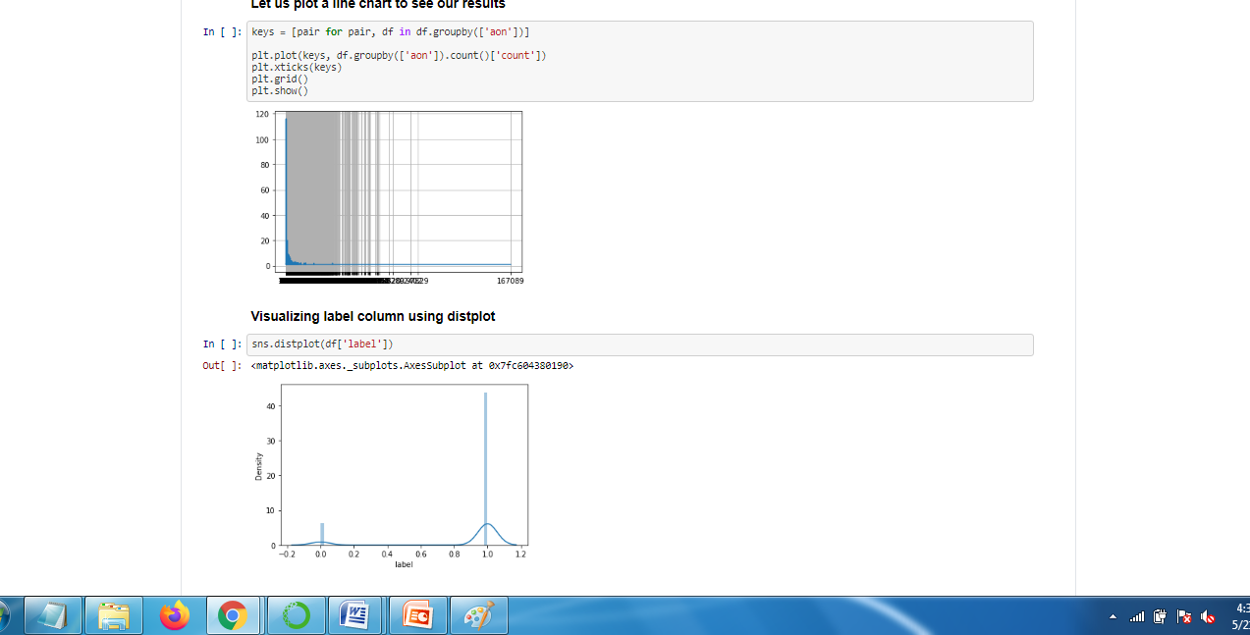

Slide 27
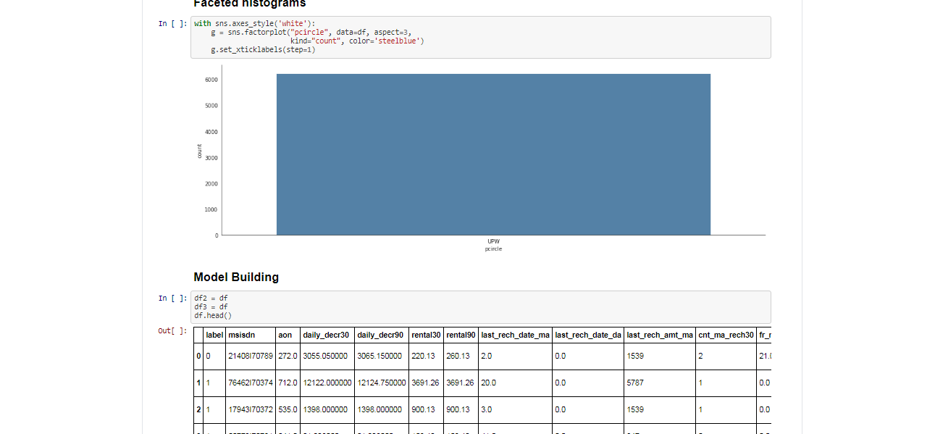

Slide 28
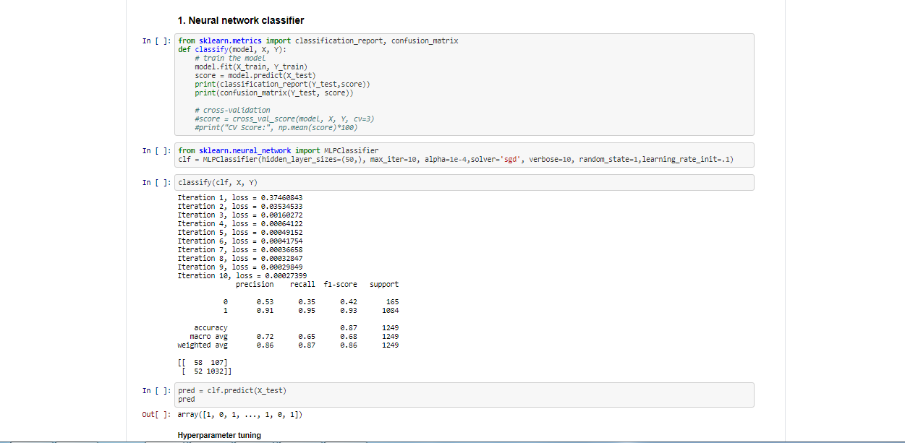

Slide 29
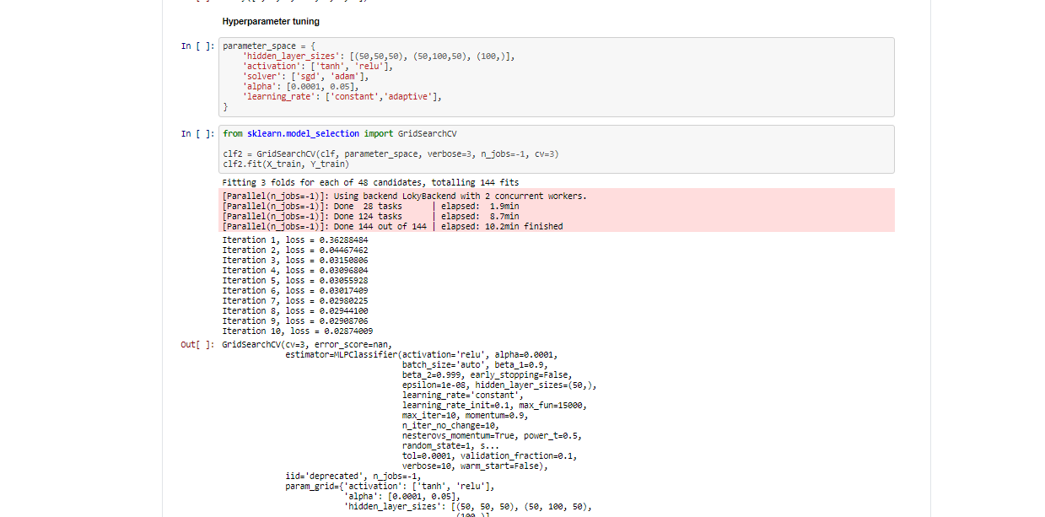

Slide 30
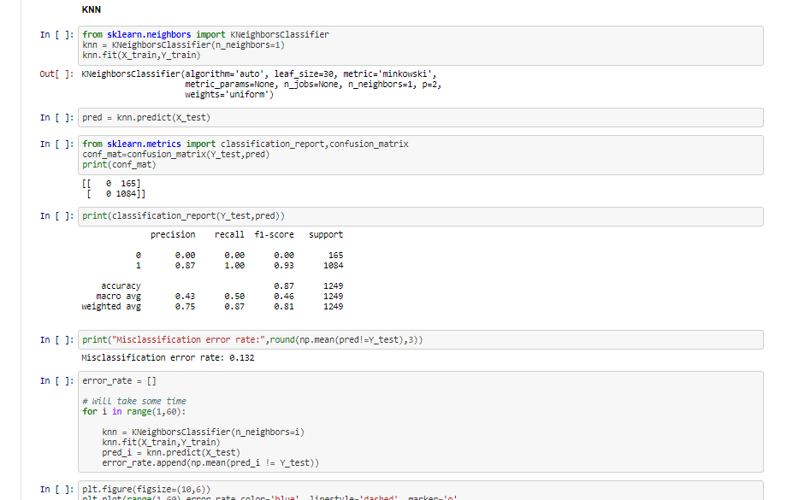

Slide 31
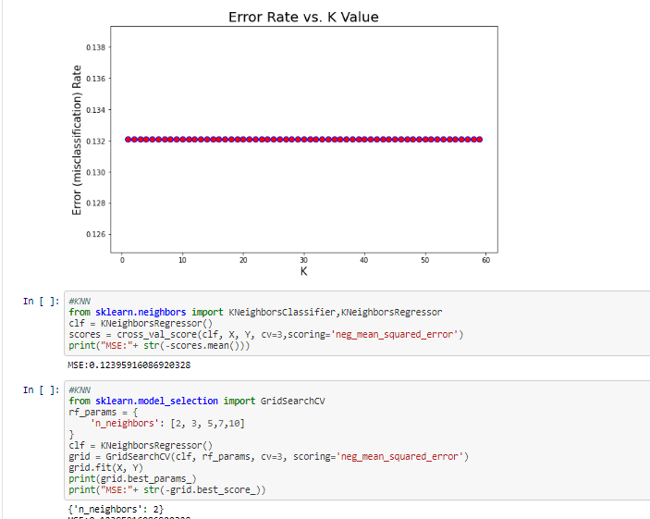

Slide 32
